Slide 1

AI개발자 트랙 미니프로젝트 6차
6차 미니프로젝트_조별 발표 템플릿
24조

Slide 2


목차
3 - Beverage
12 - Milk
42 - Agricultural Products

Slide 3
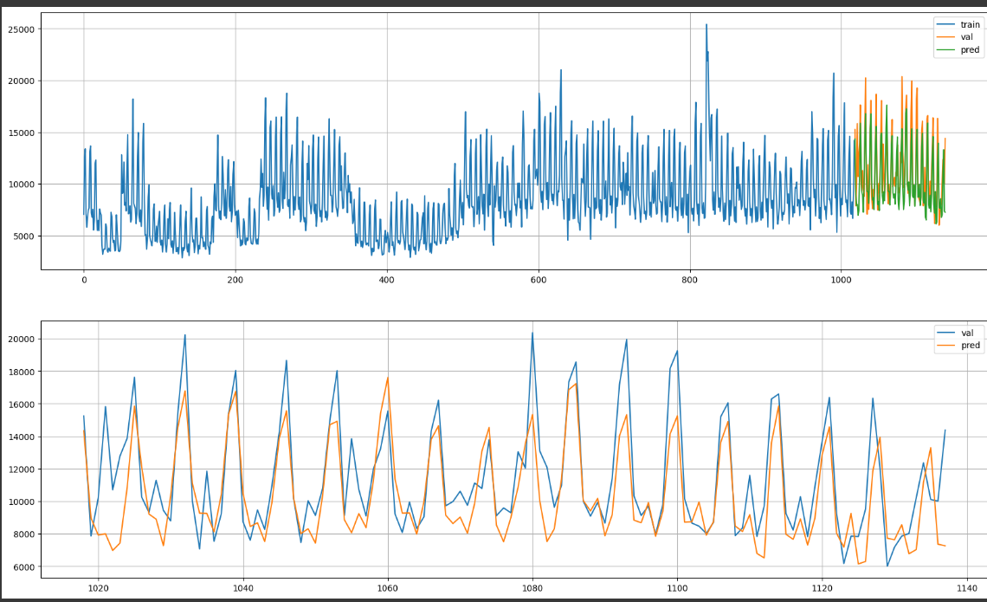
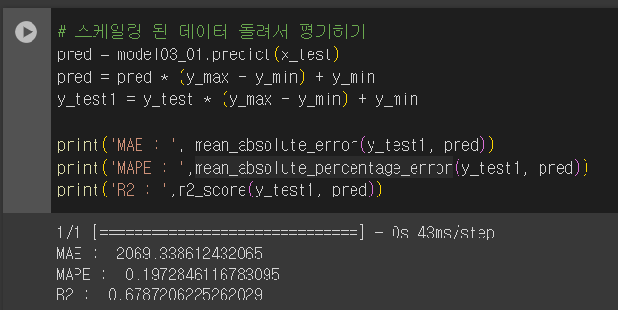
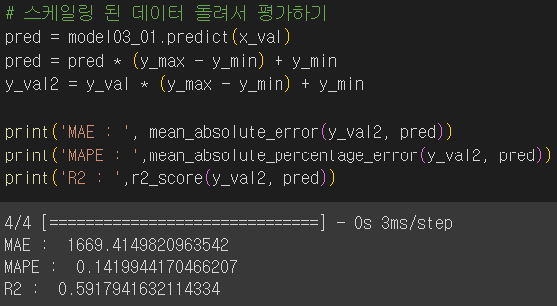
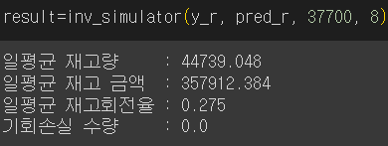
Product_ID = 3(Beverage)
학습(x_train, y_train)
테스트(x_test, y_test)

Slide 4
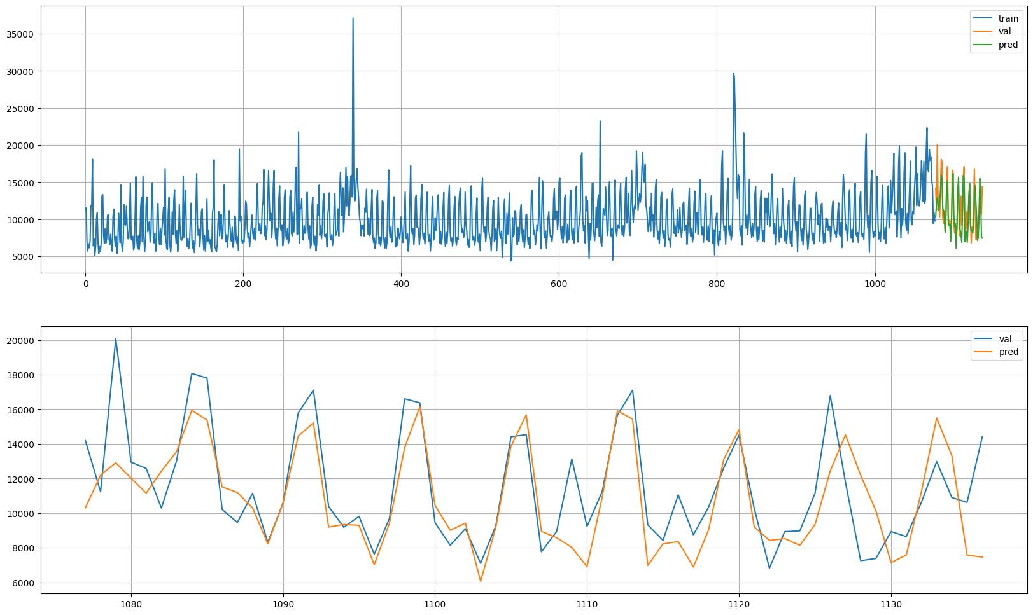
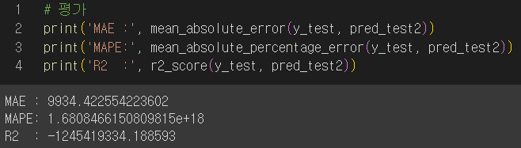
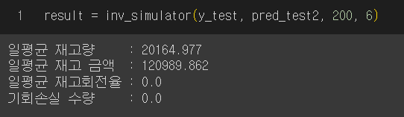
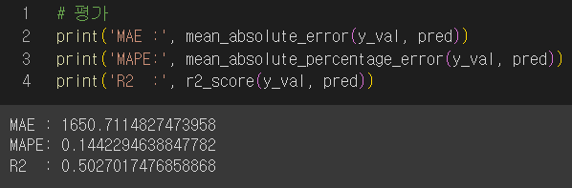
Product_ID = 12(Milk)
학습(x_train, y_train)
테스트(x_test, y_test)

Slide 5
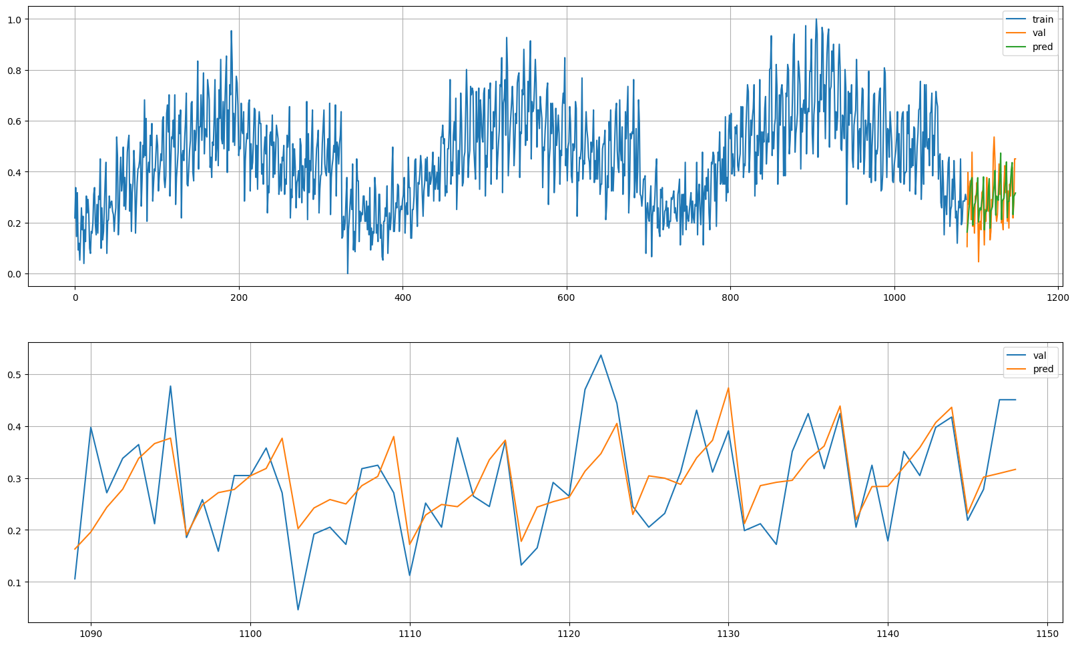
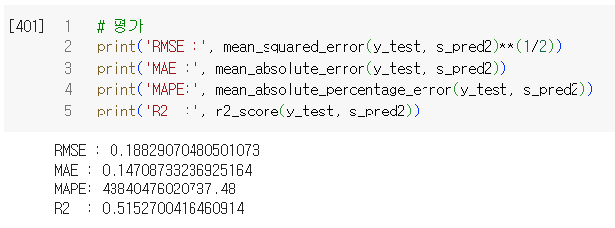
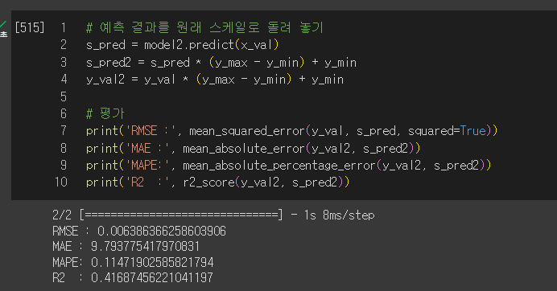
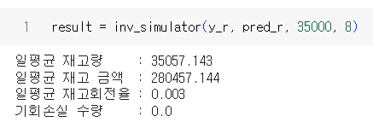
Product_ID = 42(Agricultural Products)
학습(x_train, y_train)
테스트(x_test, y_test)

